Slide 1
Welcome to the Middle Island Property Owners’ Association Conference Call Thursday, January 15, 2015 6:00 PM
This presentation was revised after the conference call to clarify the restriction on annual dues increases (slide 10) and the dues for other BHI property owners’ associations (slide 11).

Slide 2
Meeting Agenda
Introduction
Details of Agreement between MIP LLC and the MIPOA Board
Proposed Budget and Dues Structure
Planned Community Act and Amended Covenants
MIPOA By-Laws
Voting Process and Timing
Comments and Questions

Slide 3
General Parameters of the Agreement
Settlement agreement takes effect when owners of 67% of the lots on Middle Island vote to approve new covenants and to bring Middle Island under the North Carolina Planned Community Act (PCA).
MIP LLC will convey specific common assets and amenities to the property owners
MIP LLC will provide a payment of $608,000 that will be used for immediate improvements to the roads and other assets and for initial funding for our capital reserves
Before closing, MIP LLC will replace the Bald Head Creek dock, repair its bulkhead, and install new aluminum gangways there and at the Cape Creek dock
MIPOA will assume responsibility for the assets and amenities

Slide 4
Assets That Will Be Transferred to MIPOA
East Beach Drive and the gravel roads, with rights of way and easements
Middle Island Beach access, parking lot and overflow parking areas south and west of the tennis court
The marina on Cape Creek
The two Bald Head Creek docks
The truck, tractor, equipment and leasehold interest in the maintenance building
The triangle lot at the entrance to Middle Island on East Beach Drive where the Middle Island sign is located.
The undeveloped areas on the marsh known as Reserve Areas 4 & 5.

Slide 5
Future Decisions
Racquet and Swim Club
The agreement does not transfer the Racquet and Swim Club. Young Entities may:
Continue to operate the club under the current arrangement.
Transfer the club to a group of interested property owners who agree to maintain it as a racquet and swim club predominantly for the benefit of Middle Island residents.
Permanently convert and sell the site as a single family residential lot, either alone or together with the lot just north of the Racquet and Swim Club.
Middle Island Gate
All decisions about a gate at the entrance to Middle Island have been deferred for discussion following turnover of the roads. The Board will fully explore different options and present its recommendations to the property owners for discussion.

Slide 6
How the Board Developed Cost Estimates to Guide Negotiations and Budgeting
MIPOA Board independently evaluated the condition of the roads and each of the other assets to determine the cost of immediate improvements, the annual cost to maintain the asset, and the useful life and replacement costs of each asset.
These cost estimates were developed using bids from potential contractors, industry standard cost estimates, and information from other POAs and property management companies.
Negotiations with Young Entities resulted in agreement about:
Immediate improvements that Young Entities would complete prior to turnover, such as replacement of the Bald Head Creek dock and repair of its bulkhead, and
A transfer payment of $608,000 from Young Entities at the time of settlement that would fund:
Major improvements needed in 2015, most notably the rebuilding of the gravel roads
Initial contributions to asset reserve funds based on the current condition of the asset, its remaining useful life, and its replacement cost.

Slide 7
The Proposed 2015 Budget
The Proposed Budget for 2015 is based on the asset evaluations and cost estimates that guided negotiations. This initial budget has two main components:
1) A proposed allocation of the $608,000 that Young Entities will transfer to MIPOA at settlement:
$473,085 will be spent in 2015 to bring the gravel road and other important assets to a state of reasonable repair, to pay the Association’s legal and settlement expenses, and to make minor initial equipment purchases.
$134,915 will be allocated to specific reserve funds for each asset and to the general reserve fund.
2) An initial annual budget with:
Net annual operating expenditures of $108,120
Annual contributions to reserve funds of $31,499
The annual contributions to the reserve funds are based on the remaining useful life of each asset. The goal is to make realistic annual contributions now to avoid relying on large special assessments when assets need replacement.
This initial net annual budget of $139,619 would be the baseline annual budget for MIPOA going forward and the basis for determining annual dues.

Slide 8
2015 Annual Budget and Dues (excluding one-time transfer fund expenditures)
 |  | Annual net operating costs | Annual reserve contrib
NET OPERATING COSTS AND RESERVE CONTRIBUTIONS
 | Gravel Roads | $ 32,168 | $ 10,000
 | East Beach Drive | $ 3,000 | $ 3,413
 | Creek docks | $ 1,000 | $ 6,533
 | Beach access and parking | $ 12,500 | $ 2,220
 | Administrative, legal, insurance, accounting, general reserve | $ 54,292 | $ 3,000
 | Cape Creek Dock | $ 5,160 | $ 6,333
 | TOTAL | $ 108,120 | $ 31,499 | $ 139,619
NOTE: Net operating costs reflect offsetting revenue from boat owners for dockage at Cape Creek and from Young Entities for work performed on their properties.

Slide 9
General Framework for Annual Dues
In calculating proposed dues amounts, the annual expenditures and reserve contributions were allocated among Middle Island lots based on two principles:
An improved lot contributes twice the amount contributed by an unimproved lot; and
For gravel road expenditures only, a lot on the gravel road (all forest lots) contributes three times the amount as a lot not served by a gravel road (all East Beach lots). For all other expenditures, forest and East Beach lots contribute equally.
For 2015, approval of the covenants includes approval of the initial budget and dues for the Association.
For the 2016 budget year and beyond, the proposed Covenants provide a process for budget review and approval (or rejection) by the property owners and a limit of 5% on annual dues increases for each type of lot.

Slide 10
Proposed Dues for 2015
Improved forest lot (23) | $2041
Improved East Beach lot (14) | $1576
Unimproved forest lot (63) | $1021
Unimproved East Beach Lot (8) | $788
These figures are the base year amounts and are included in the proposed Covenants.
Annual increases are limited to a maximum of 5%, unless approved by 2/3’s of the votes of property owners voting in person or by proxy at a special meeting. Special quorum requirements apply.

Slide 11
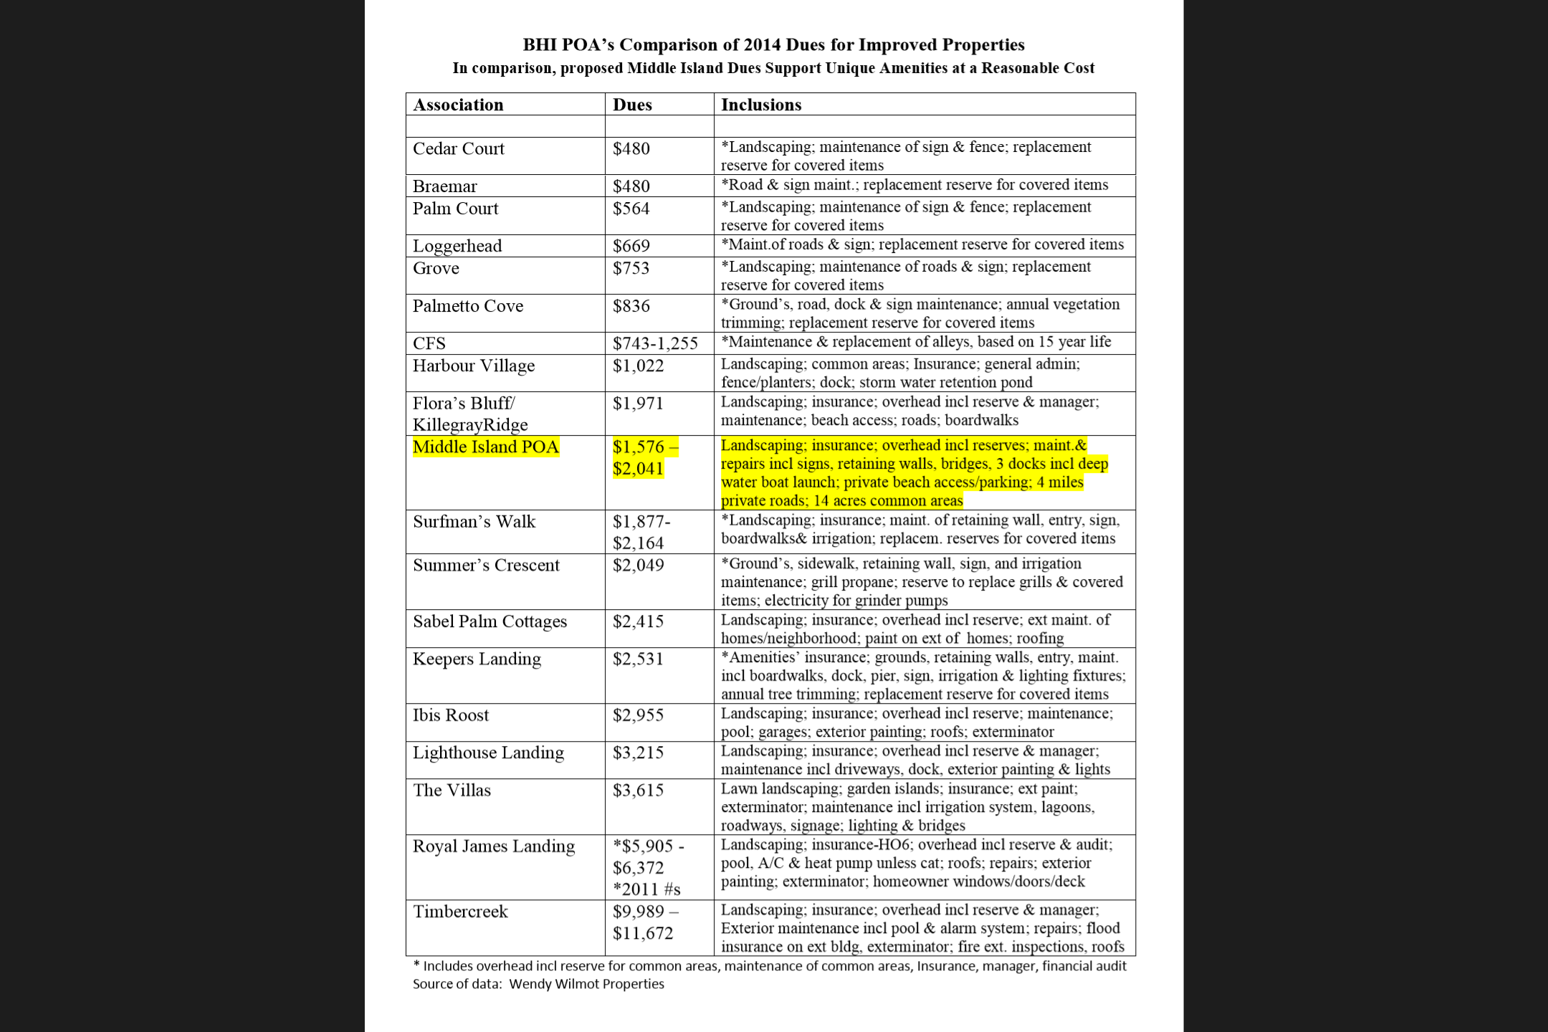
Note: The annual dues for properties in Stage 1 and Stage 2 include both POA dues and Stage 1 or Stage 2 dues. MIPOA members would pay only MIPOA dues.

Slide 12
The Proposed Amended and Restated Covenants
The Amended and Restated Declaration of Covenants, Conditions, and Restrictions of Middle Island (“the Covenants”) is the key document in the transition to owner control of Middle Island.
The Covenants provide a strong foundation and organizing structure for property owners to work together to maintain the quality and integrity of our special community and enhance our property values.
The Covenants describe the governance and funding of the planned community and the conditions and restrictions that apply. Specifically, the Covenants:
Restate provisions in the existing covenants for Middle Island or the Bald Head Association, including the architectural review process, siting and setback provisions;
Identify the Association’s common areas and amenities that Young Entities will transfer to MIPOA;
Adopt the provisions of the North Carolina Planned Community Act (PCA); and
Adopt additional procedures governing how MIPOA will operate, including a specific budget process with significant restrictions on annual dues increases and special assessments.

Slide 13
The Covenants (continued)
The proposed Covenants also include the dues amounts for 2015 and these additional protections:
Restrictions are placed on non-budgeted Board expenditures.
Specific reserve funds are established for each type of asset, with the requirement that major repairs and replacements be funded first from the reserve fund for that asset, further decreasing the likelihood of a special assessment;
In the unlikely event of a weather catastrophe, property owners will be able to prioritize rebuilding, to the extent that the cost of major repairs and replacements exceeds the funds in the asset’s specific reserve fund.

Slide 14
The North Carolina Planned Community Act (PCA)
Adoption of the PCA provides important protections to Middle Island property owners and allows MIPOA to equitably distribute the costs of maintaining the roads and common assets.
The PCA includes:
a statement of the limited powers of the association and the board (restated in the Covenants), including notice and quorum requirements for meetings of the property owners;
a transparent budgeting process to establish the annual assessment (“dues”), including a way for property owners to reject the proposed budget and dues (further specified in the Covenants);
provisions governing insurance (further addressed in the Covenants);
a process for collecting assessments, including, if necessary, the ability to place an enforceable lien on the property (without this lien provision, the Association could not maintain the roads and amenities and therefore could not responsibly take possession of them from Young Entities);
additional property owner protections, including a requirement for supermajority votes to change the covenants and to levy special assessments.

Slide 15
General Description of the proposed Amended By-Laws
The amended MIPOA by-laws are a companion document to the Covenants that set forth rules and procedures governing MIPOA decision-making procedures, Board elections, meeting requirements, etc.
The amended by-laws include provisions dealing with:
Annual property owner meetings;
Voting rights of property owners;
Nomination and Election procedures for the MIPOA Board, MIPOA meeting and quorum requirements, powers and duties, and indemnification;
Assessment procedures and reserve funds to maintain and improve the common assets and amenities.

Slide 16
The Approval Process
Over the next few days, the Board will be reaching out to property owners individually to answer any remaining questions.
By early February, the MIPOA Board and MIP LLC will circulate to all property owners an approval packet containing the proposed new covenants, revised by laws, and other information.
After ample opportunity to review the documents, property owners will be asked to consent to the new Covenants. Approval of the covenants also indicates the property owner’s approval of the adoption of the Planned Community Act for Middle Island and approval of the Association’s budget and dues for 2015. None of these actions become effective unless approved by the owners of 67% of the Middle Island lots.
If the covenants are approved, closing is currently scheduled for February 28, 2015. If necessary, closing can be re-scheduled by mutual agreement with Young Entities.
New MIPOA Bylaws will be adopted at the first property owners’ meeting after closing because amendments to the Bylaws are required to be made at a regularly scheduled meeting.

Slide 17
Comments and Questions Are Welcomed, Now and Later
Please contact any member of the Board with any questions you may have, or send an email to middleislandpoa@gmail.com

